Slide 1

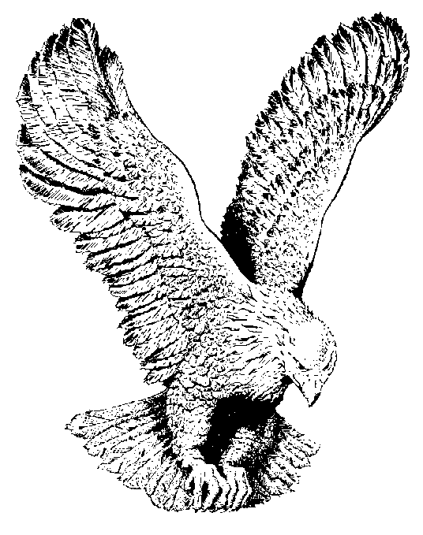
JESUS OME KANNAYA
Jesus Ome kannaya
I worship You today
Jesus ome kannaya
I bow before Your throne

Slide 2
Nara Nara Nara oh
Nara ekelem jiri bia
Onye di Nara Nara Nara oh Nara ekelem jiri bia
onye di nso
Onye di nso
I lift my hands to You
Onye di nso,
Cause only You deserve it
Onye di nso, (Holy One)
ihi nemerem ebuka (What You are doing for me is too big)
Chionye di nso, (Holy one)
To You I give my all

